Slide 1
FAIR data at ELI
Florian Gliksohn, Birgit Plotzeneder, Tamás Gaizer, Jakub Grosz, Lajos Schrettner, Mousumi Upadhyay Kahaly
Trieste, Italy, 05 November 2019

Slide 2

ELI in Brief
ELI ERIC will be the world’s most advanced laser research infrastructure
First international research infrastructure built completely in Central Europe
Funded in synergy between ESIF, National and Framework funds, after EU approval and delivered through a community effort

Slide 3
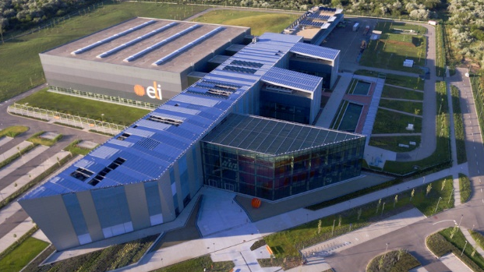
ELI-ALPS
X-UV and X-ray fs/atto-pulses, for temporal investigation of dynamics in atoms, molecules, plasmas and solids.

Slide 4
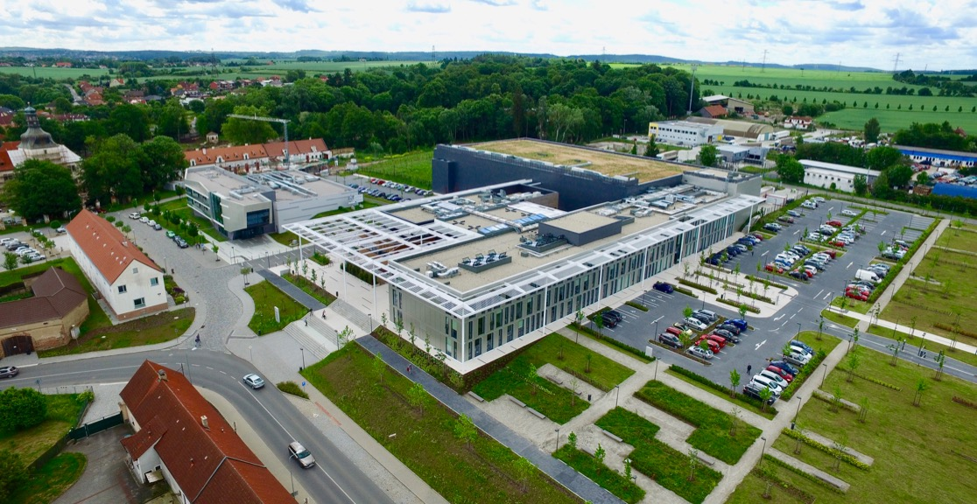
ELI BEAMLINES
The forefront of high-intensity, high-energy density, short-pulse laser systems

Slide 5









ELI Timeline
Joint
Initiation
Parallel
Implementation
Joint
Operation
ELI-Beamlines
Integration
13 Countries
40 Research Institutions
ELI
Czech Republic
ESFRI
ELI-PP
ELI-ALPS
Hungary
ELI-NP
Romania
2006
2007
2010
2011
2013
2017
2019
PP Consortium
ELI-DC AISBL
ELI - ERIC
MoU
5

Slide 6
Data in ELI ERIC Draft Statutes
Article 9 Data and Intellectual Property Rights Policy
‘Data’ refers to all information collected by USERS and ELI employees while performing scientific experiments under the ACCESS FOR USERS Policy and performing operations of the ELI Facilities.
The term ‘Intellectual Property’ (hereinafter referred to as ‘IP’) shall be understood in accordance with Article 2 of the Convention Establishing the World Intellectual Property Organisation signed on 14 July 1967a.
Open Access shall be favoured for data collected as a result of the use of the ELI FACILITIES and, to the extent possible in case of software and computer programs created by the Organisation, Open Source principles shall be considered.
ELI shall adopt a Data and Intellectual Property Rights policy and specific processes and procedures in accordance with Article 21 (9) e

Slide 7

Elements of ELI Data Policy
In the area of Data, the Charter invites RIs to:
Define a transparent data policy, which is accepted by the users upon submitting the proposal
Maintain a data management plan
Encourage the open access of the data after a certain embargo period (during which the experimenter has exclusive access to the data and can publish results based on them)
Envisaged approach at ELI:
ELI as custodian of the data (archiving obligation)
Catalogue of metadata to allow search
Publication rights for the data belong to the experimenter
Publication by ELI after embargo period (3 years considered) with copyright for the experimenter.

Slide 8
Challenges and Way-forward
The amount of data will not be the main challenge (10+ PB of archived data per annum)
Standardisation challenge (approach to metadata, detectors, etc.) as priority
Cultural issue within due to a “lab approach” to experimental data (no significant experience on making data available and (re-)usable within the community)
Need to make data available not challenged, but doubts from insiders and users that going online is valuable
Need for cohesive vision and strategy going beyond the photon factory mission to that of a data provider
need for champions and trailblazers
Focus on core services for early adopters
PaNOSC is helping structuring the thought and policy process

Slide 9
Challenges and Way-forward
PaNOSC is the best environment for ELI to address these challenges:
Consortium gives access to resources and experience
Commitment to adopting PaNOSC Data Policy Framework
Push for integration of data-related activities within ELI
Push for long-term vision in terms of services
Cross-community approach
Key conditions to success:
Get involvement from scientists and users early on (data policy)
Focus on core services for early adopters
Need for ELI to team up with laser community (Laserlab not involved in ExPands)
Need for champions and trailblazers within the community
Training of scientists and users

Slide 10
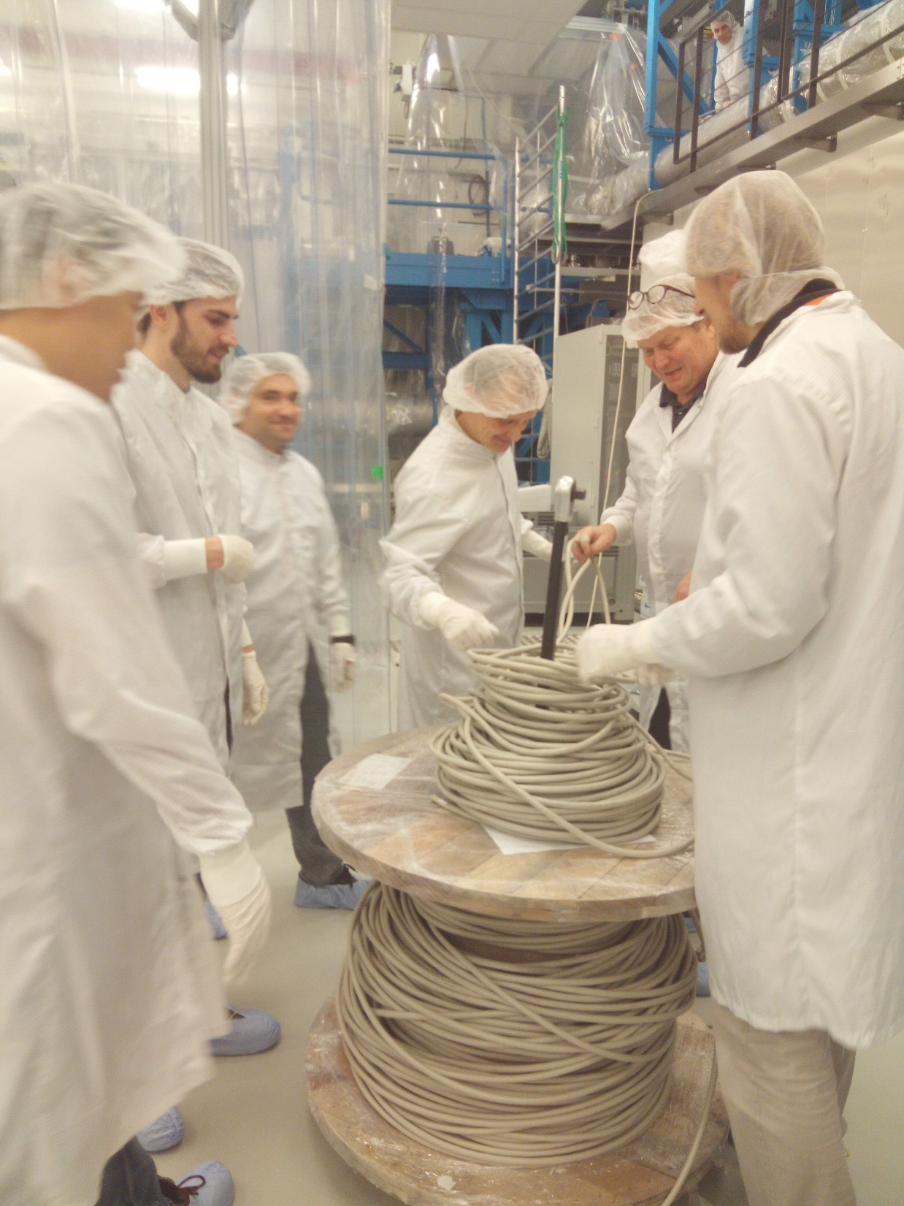
Data at ELI Beamlines
Things are getting exciting now!
First user call with “unfriendly” users in summer 2019, worst case DAQ scenario: 12TB/hr
“First light” milestone end of 2019 with flagship 1PW laser – plasma physics chamber

Slide 11





Data at ELI Beamlines
Things are getting exciting now!
First user call with “unfriendly” users in summer 2019, worst case DAQ scenario: 12TB/hr
“First light” milestone end of 2019 with flagship 1PW laser – plasma physics chamber
12 TB/hr DAQ, 1TB/hr system data
Big data/CS challenges:
Getting the beams onto the targets in a quality and with a reliability that produces good data
Resources tied up by commissioning, finding a balance
Commissioning more experiments
Operating more experiments
Improving infrastructure
Increasing service level
Everything is fluctuating and we’re building something from 0
Organizational structure and processes
Priorities and needs

Slide 12
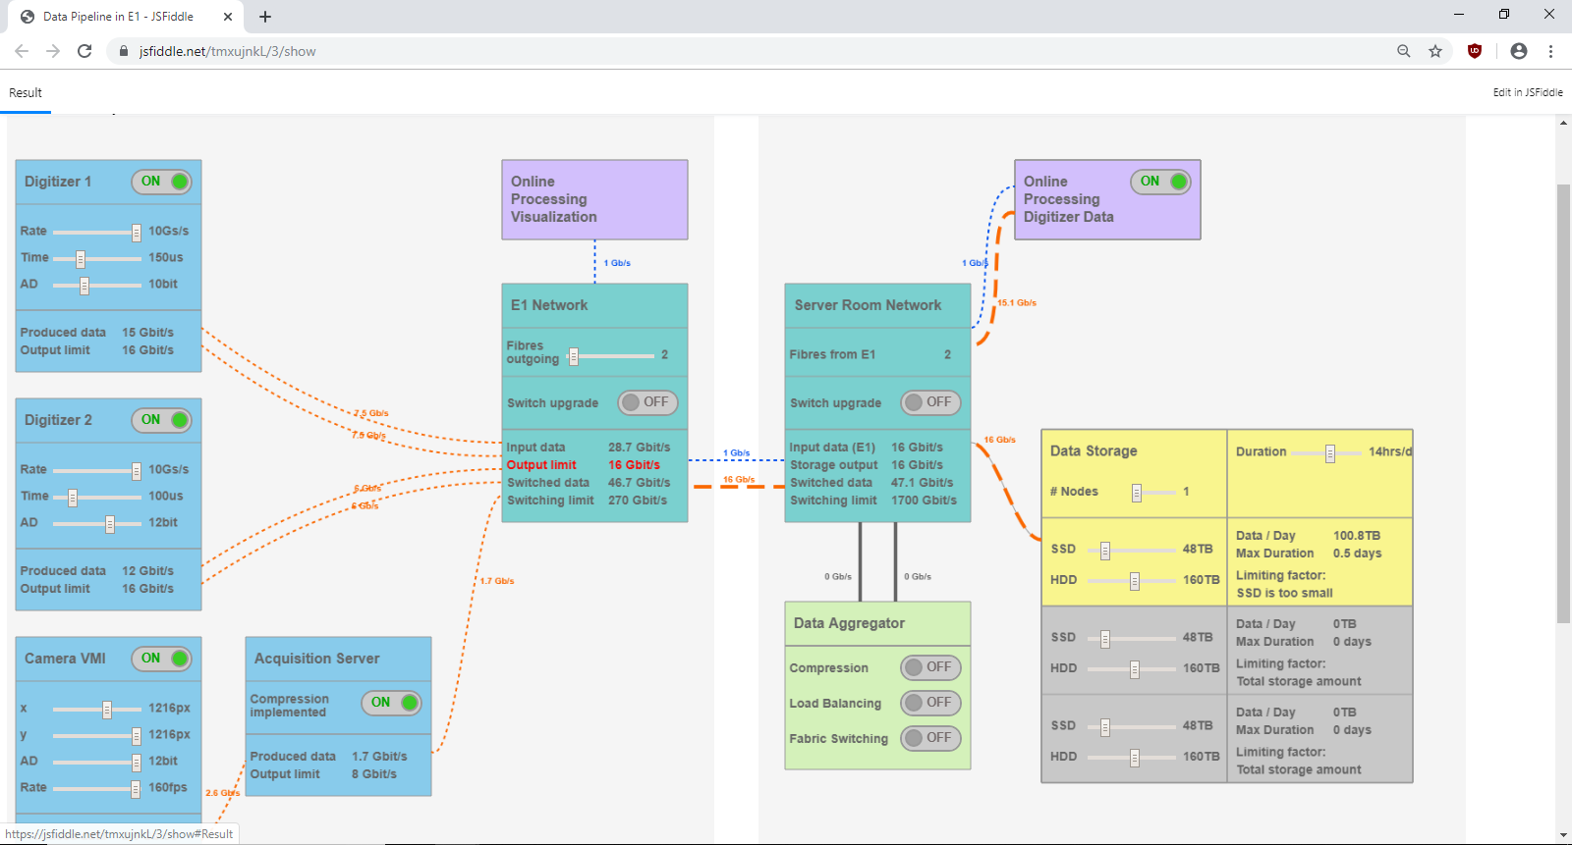
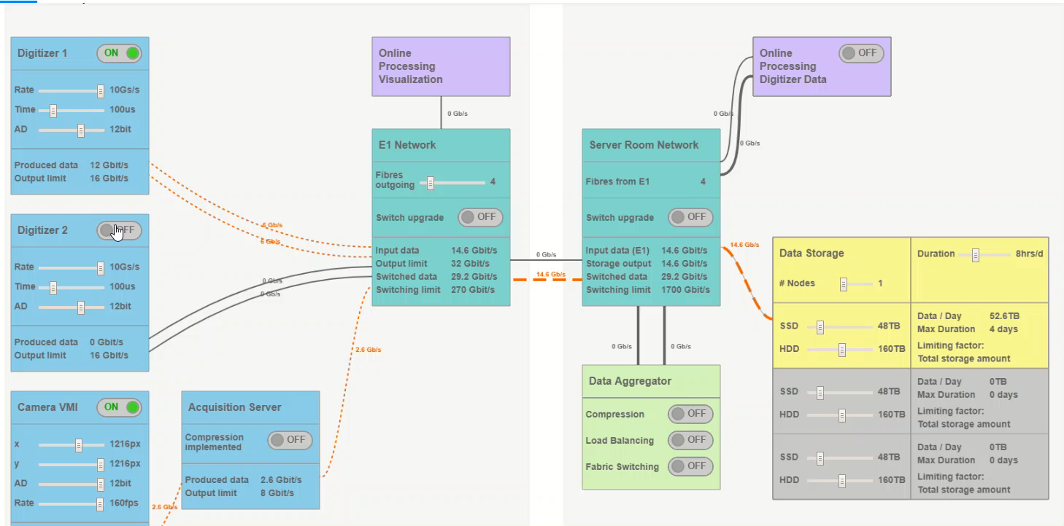

Early-phase projects (2019)

Slide 13

Early-phase projects (2019)
Data production starting to be significant
Data services very much based on immediate needs
Data Transfer (“too much data for a USB stick”)
Early Analysis Projects (“too much data for my laptop but need to steer experiment online”)
Early interest in metadata (“what physical meaning does -32767 have?”)
Early interest by scientists in data formats
Conventions / codes / tools
File sizes
“Publication-ready” outputs

Slide 14
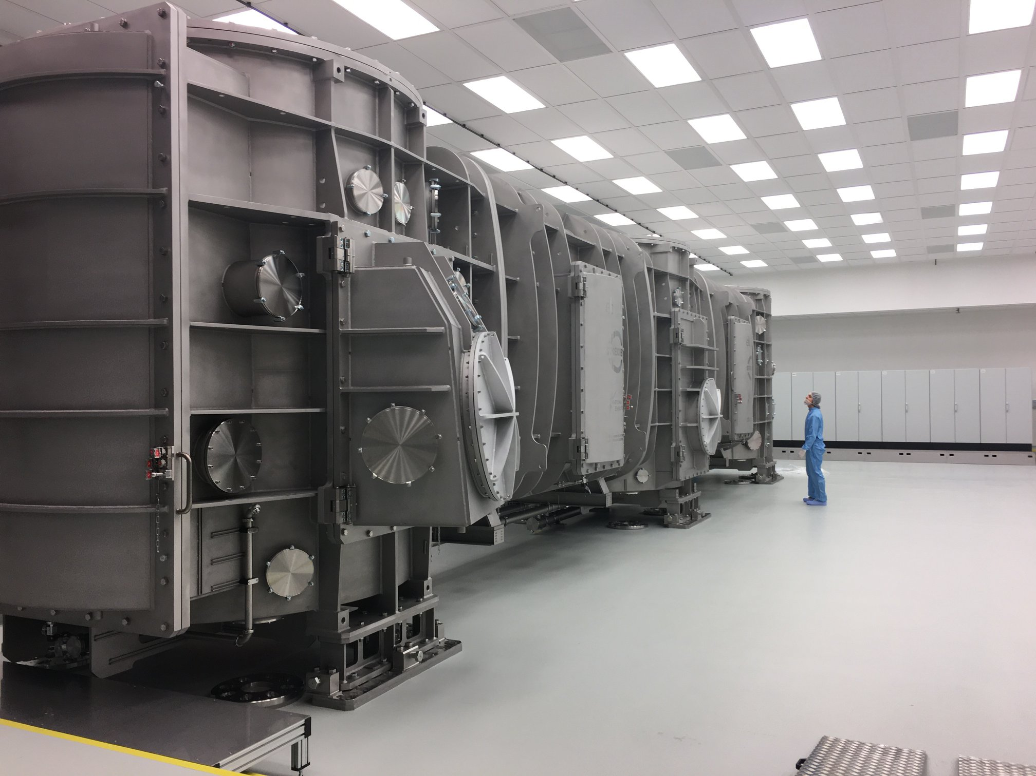
2020+
Consolidated software-defined storage in 01/2020
Early user platform in 2020
“User journey” with most key elements identified, gradual implementation
1-2 significant data sources added/year

Slide 15
Thank you for your attention
florian.gliksohn@eli-laser.eu

